Slide 1
Chile
Embassy of Chile in Poland
Consul Lorena Guzmán
Romina Valenzuela (ProChile)
April 13th, 2016

Slide 2
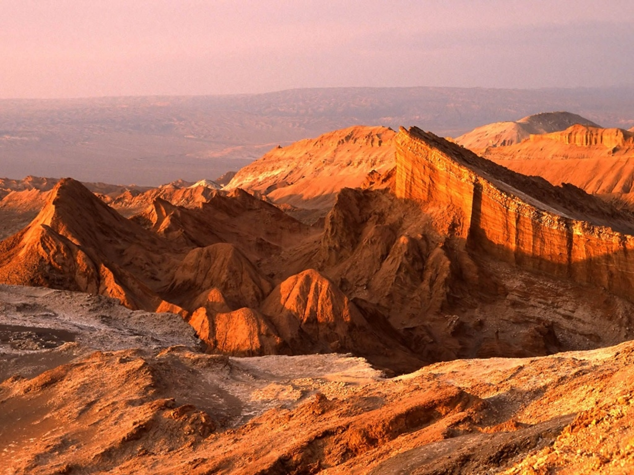
Did you know…
Chile is a beautiful and diverse country located in South America. Very long and narrow.
Variety of climates. From the driest desert in the world (Atacama) in the North to ecological reserves, lakes and woods in the South. And also beaches, snowy mountains and volcanoes, and glaciers and ice fields.

Slide 3
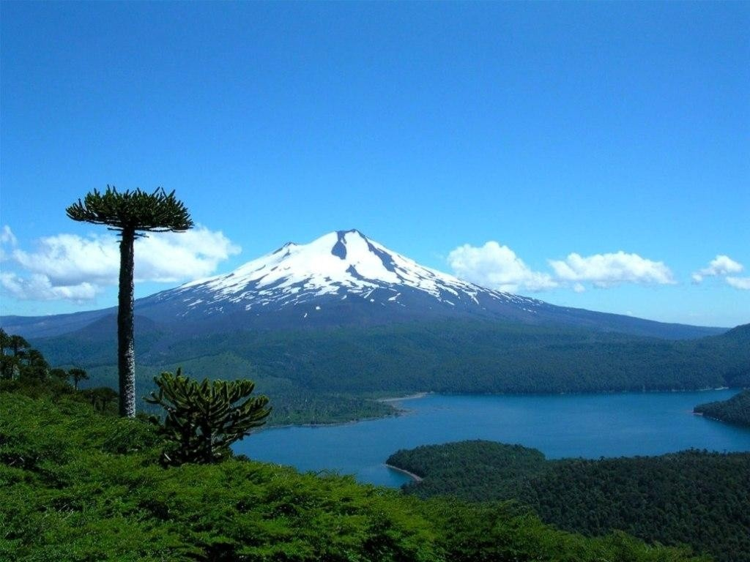
Chile has over 30 astronomic and touristic observatories all along the country, and 5 locations have received the category of World Heritage by UNESCO:
National Park Rapa Nui in Easter Island
Churches of Chiloé
Historic quarter of the Seaport City of Valparaíso
Humberstone and Santa Laura Saltpeter Works
Sewell Mining Town

Slide 4
Some facts…
Official name | República de Chile
Area: | 756.945 km2
Limits: | Peru, Bolivia, Argentina, Pacific ocean
President: | Michelle Bachelet Jeria (since 11 March 2014)
Exports | copper, fruit, fish products, paper and pulp, chemicals, wine
Imports | Petroleum and its products, chemicals, electrical and telecommunications equipment, industrial machinery, vehicles, natural gas
GDP per cápita | US$ 23.800 (2015)

Slide 5
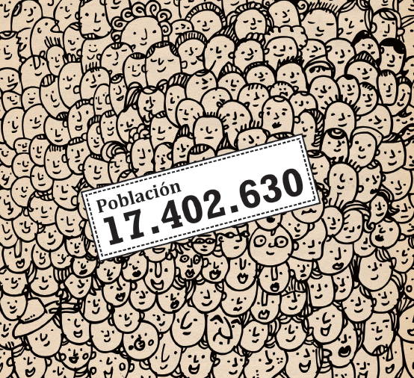
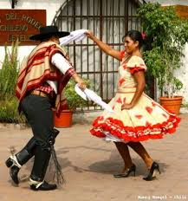
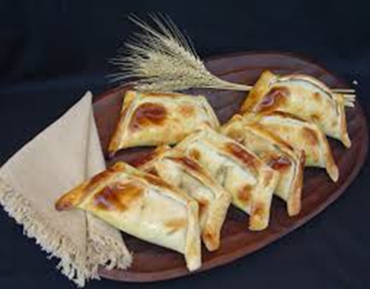
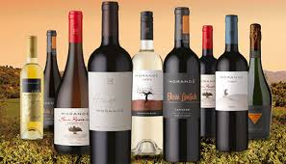
We are mixed…. 93.4 % of the population is mestizo (mainly European immigration + native people);
The official language of Chile is Spanish. Also mapudungún ( Mapuche ) , Aymara ( Andean region north) and Rapa Nui (Easter Island).
And it’s a land of distinguished personalities like the Nobel laureat Gabriela Mistral and Pablo Neruda.
Empanadas, red wine and cueca are ever present in our traditional celebrations and national holidays in September 18th .

Slide 6
Chile in 3 minutes

Slide 7
To find more…
This is Chile http://www.thisischile.cl/
Chile travel http://chile.travel/en/
Learn Chile http://learnchile.cl/en/
Start up Chile http://startupchile.org/
English opens doors (volunteer program) http://www.centrodevoluntarios.cl/
Chilean cooperation http://www.agci.cl/
Chile abroad http://chile.gob.cl/en/
Gobierno de Chile http://www.gob.cl/
varsovia@consulado.gob.cl

Slide 8
ECONOMIC AND COMMERCIAL POLICY
International and Regional Economic Integration
Development Exports
Protection of Investments
Free Trade Policy
Active Member of the World Trade Organization
Strong actor in Bilateral Trade
TRADE POLICY
25 agreements with 64 markets
It represents 64,1% of the world population
CHILE DESIGNING XXI CENTURY TRADE RULES
Pacific Alliance
Trans-Pacific Partnership (TPP)

Slide 9
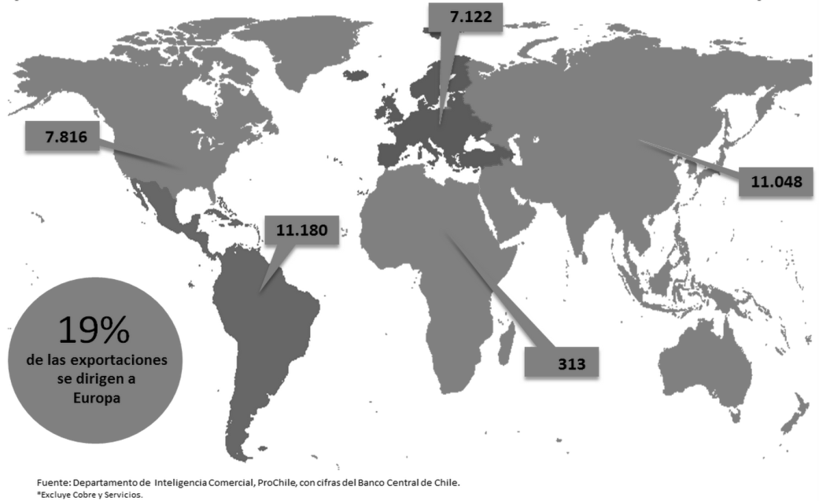
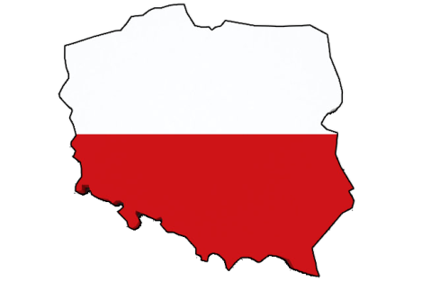
CHILEAN EXPORTS TO THE WORLD
COMMERCIAL EXPORTS
19%
Exports to Europe
CHILEAN EXPORTS: geographical area, 2014. (US $ Millions)

Slide 10
CHILE – POLSKA: Bilateral Trade
Product | Amount (USD)
Machines, nuclear reactors, boilers, and mechanical appliances. | 17.410.000
Appliances and electrical equipment | 29.768.000
Land vehicles | 3.532.000
Articles of stone, plaster, cement | 5.400.000
Essential oils and resinoids | 4.059.000
Pharmaceutical products | 4.878.000
Product | Amount (USD)
Fresh or frozen fish | 34.303.000
FruitS and dried FRUITS | 25.225.000
Drinks, alcohol and vinegar | 14.785.000
Legumes, vegetables, fruits or other plant parts. | 2.158.000
Inorganic chemicals | 1.478.000
Wood charcoal and articles of wood | 618.000
COMMERCIAL EXCHANGE
Source: Trademap

Slide 11
About us: BIURO HANDLOWE PROCHILE
PROMOTION OF EXPORTS AND SERVICES
ATTRACTION OF FOREING INVESTMENT AND TOURISM
COMMERCIAL OFFICE
More than 40 years in the world
Only latinamerican country with Commercial Office in Poland
55 Commercial Offices in the world
CONTACT
Phone: +48 22 842 18 / +48 22 842 28
Fax: +48 22 642 42 36
Address: Okrężna 62, 02-925 Warszawa
Hours: 09.00 - 17.30 Hrs.
Email: polonia.varsovia@prochile.gob.cl
Assistants:
Director:
Enrique Carrasco
Andrzej Gurnik
Katarzyna Kaźmierska

Slide 12
Gracias

